Slide 1
Business Intelligence Dashboard
Instructor: Norman Lo

Slide 2
Objectives:
// What is a BI Dashboard?
// Benefits of a BI Dashboards
// Best BI Dashboard Practices
// Real World BI Dashboard

Slide 3
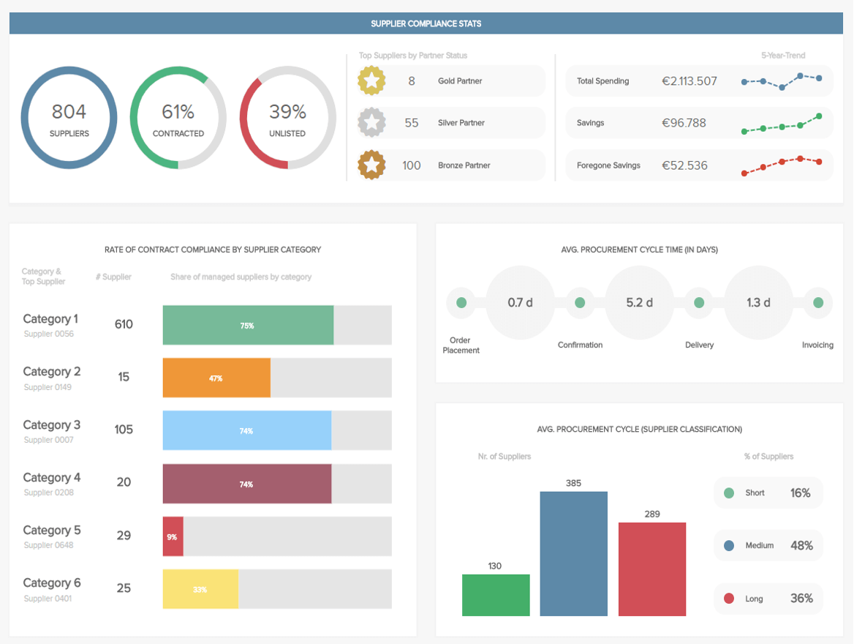
What is a BI dashboard?
BI dashboard — is an information management tool that uses data visualization to display KPIs (key performance indicators) tracked by a business to assess various aspects of performance while generating actionable insights.

Slide 4
Key Benefits of a BI Dashboard
The purpose of a BI dashboard is to help business users make better-informed decisions by letting them gather, consolidate and analyze their data – and of course, visualize it in a meaningful way.
To outline the unrivaled value of creating such a dashboard, here are the primary benefits of utilizing a BI dashboard:

Slide 5
BI Dashboard Benefits
Trend Identification
Increase Efficiency
Real-time Analysis for Instant Insight
Interactive Data Vis
Self-Service Features
Freedom & Flexibility

Slide 6
BI Dashboard Best Practices
Identify Reporting Requirements
Know Your Dashboards
Design Data to Avoid Cluster
Design Data with a Clear Visual Order
Choose the Right Data Vis
Provide Data Context
Consider Your Target Audience
Tell a Tale with Your Metrics
Refine - Perfect - Repeat

Slide 7
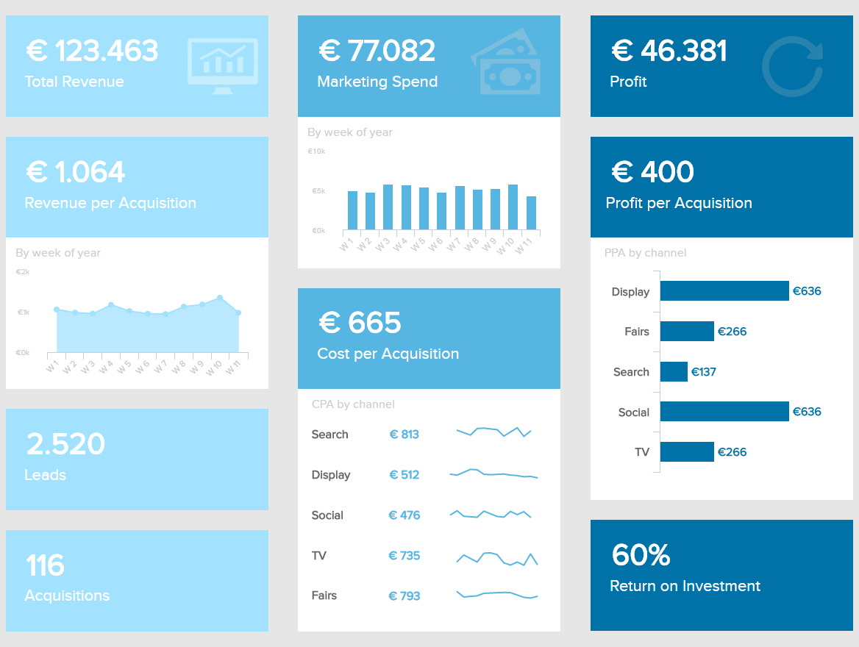
Real World BI Dashboard
Marketing KPI Dashboard
Notes:
Operational Dashboard:
Social media dashboards show the amount of Twitter retweets, Facebook likes, followers, shares, etc. This dashboard is helpful for those businesses that want to see the analytics behind their social media activity.
Production dashboards that track and display the number of products that have been created, defects that have been observed, and products that have been shipped. This dashboard is seen as a helpful dashboard-type for marketing purposes.
Help desk or solution dashboards display the total number of tickets received per hour, tickets being resolved or reopened, and the average time it takes to fix a problem.
Strategic Data Dashboard:
An HR department might utilize a strategic dashboard to gleam insights concerning its employees. Employee retention is crucial to building a successful business and can be adjusted and improved based on employee metrics.
A manufacturing department could utilize a strategic dashboard to observe product return rates, then investigate trends as they develop. Using the reported data, the department could then lower or increase its rate of productivity.
Analytical Dashboard:
Analytical dashboards enable businesses to take a microscopic look at their data to reveal valuable patterns and trends. However, the data utilized and displayed by an analytical dashboard needs to be accurate and up-to-date and typically requires more training to use correctly than an operational dashboard

Slide 8
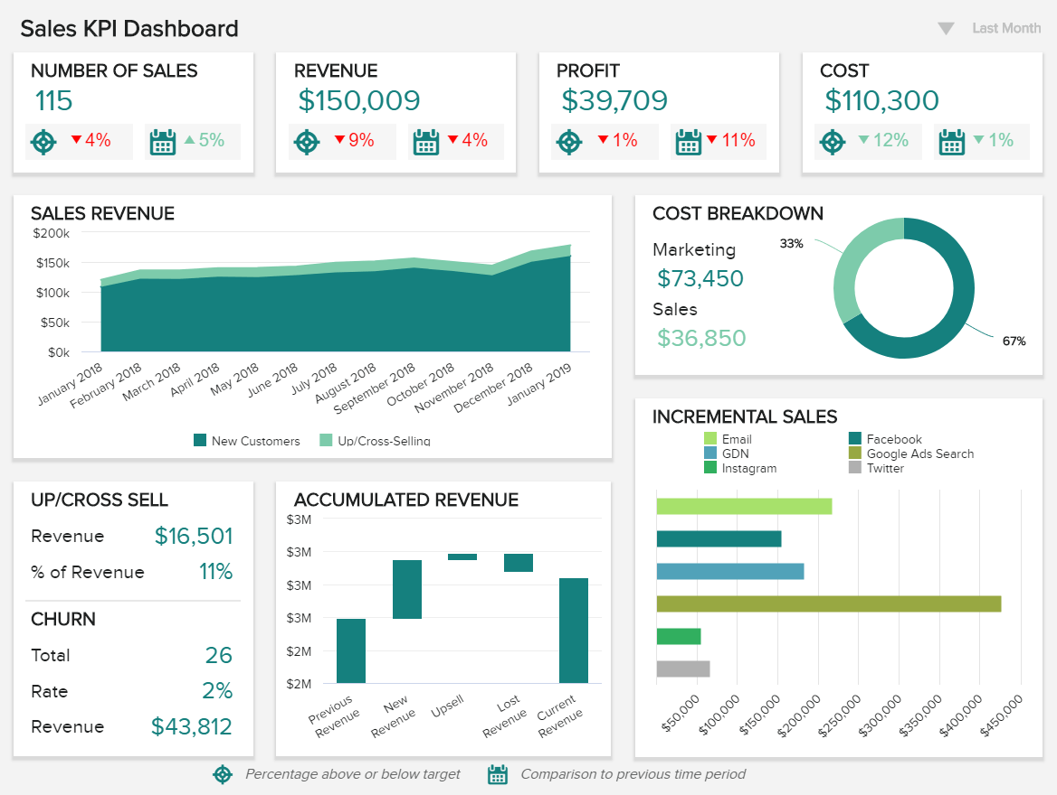
Real World BI Dashboard
Sales KPI Dashboard
Notes:
Operational Dashboard:
Social media dashboards show the amount of Twitter retweets, Facebook likes, followers, shares, etc. This dashboard is helpful for those businesses that want to see the analytics behind their social media activity.
Production dashboards that track and display the number of products that have been created, defects that have been observed, and products that have been shipped. This dashboard is seen as a helpful dashboard-type for marketing purposes.
Help desk or solution dashboards display the total number of tickets received per hour, tickets being resolved or reopened, and the average time it takes to fix a problem.
Strategic Data Dashboard:
An HR department might utilize a strategic dashboard to gleam insights concerning its employees. Employee retention is crucial to building a successful business and can be adjusted and improved based on employee metrics.
A manufacturing department could utilize a strategic dashboard to observe product return rates, then investigate trends as they develop. Using the reported data, the department could then lower or increase its rate of productivity.
Analytical Dashboard:
Analytical dashboards enable businesses to take a microscopic look at their data to reveal valuable patterns and trends. However, the data utilized and displayed by an analytical dashboard needs to be accurate and up-to-date and typically requires more training to use correctly than an operational dashboard

Slide 9
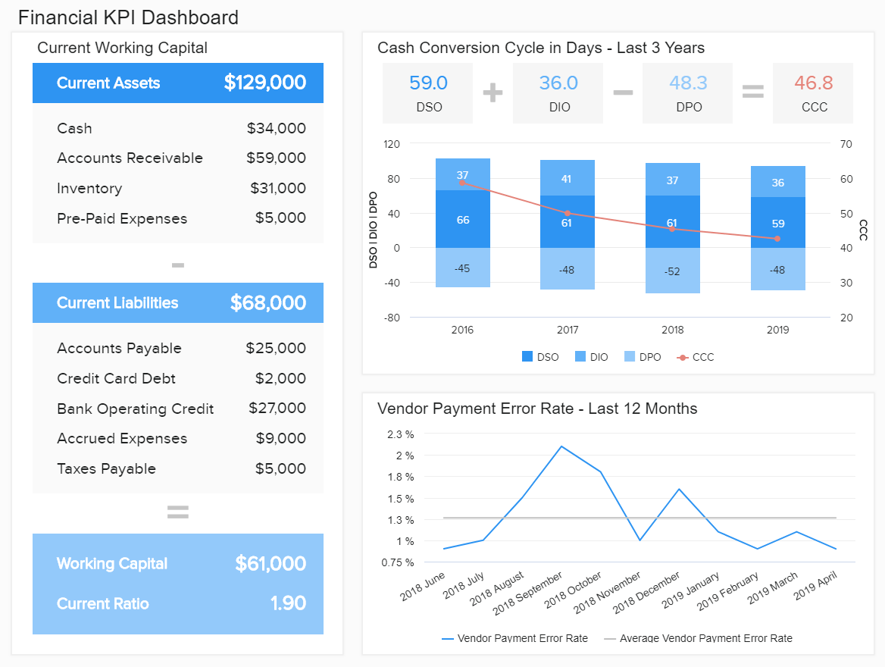
Real World BI Dashboard
Financial KPI Dashboard
Notes:
Operational Dashboard:
Social media dashboards show the amount of Twitter retweets, Facebook likes, followers, shares, etc. This dashboard is helpful for those businesses that want to see the analytics behind their social media activity.
Production dashboards that track and display the number of products that have been created, defects that have been observed, and products that have been shipped. This dashboard is seen as a helpful dashboard-type for marketing purposes.
Help desk or solution dashboards display the total number of tickets received per hour, tickets being resolved or reopened, and the average time it takes to fix a problem.
Strategic Data Dashboard:
An HR department might utilize a strategic dashboard to gleam insights concerning its employees. Employee retention is crucial to building a successful business and can be adjusted and improved based on employee metrics.
A manufacturing department could utilize a strategic dashboard to observe product return rates, then investigate trends as they develop. Using the reported data, the department could then lower or increase its rate of productivity.
Analytical Dashboard:
Analytical dashboards enable businesses to take a microscopic look at their data to reveal valuable patterns and trends. However, the data utilized and displayed by an analytical dashboard needs to be accurate and up-to-date and typically requires more training to use correctly than an operational dashboard

